Slide 1

FOOD FOR MANKIND
DR. PRAKIT SUKYAI
DEPARTMENT OF BIOTECHNOLOGY FACULTY OF AGRO-INDUSTRY

Slide 2


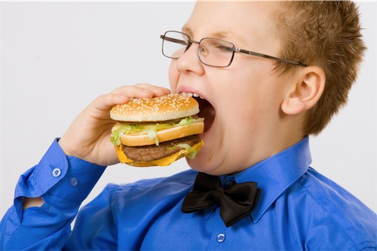


PAGE: 1 - FOOD FOR MANKIND
HUMAN
FOOD
DR.PRAKIT SUKYAI

Slide 3



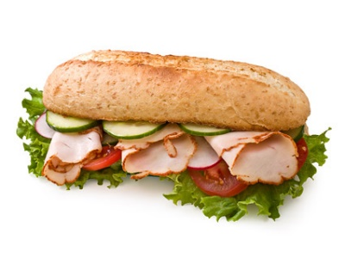

PAGE: 2 - FOOD FOR MANKIND
FOUR REQUISITES
Resident
Medicine
Clothes
Food & Water
DR.PRAKIT SUKYAI

Slide 4

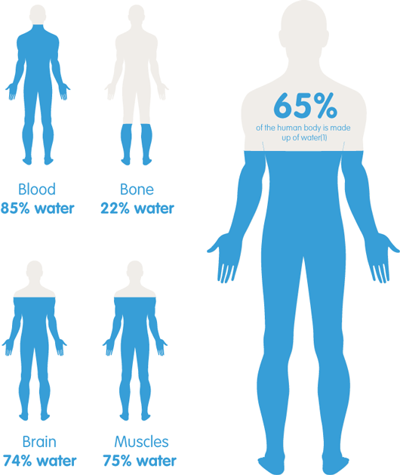
PAGE: 3 - FOOD FOR MANKIND
FOOD & WATER FOR MANKIND
DR.PRAKIT SUKYAI

Slide 5




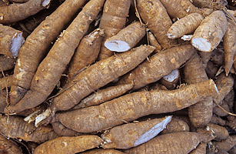
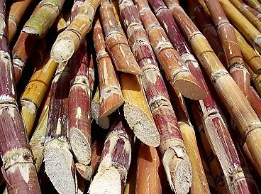
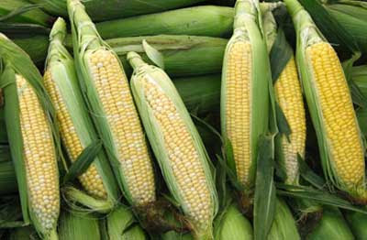
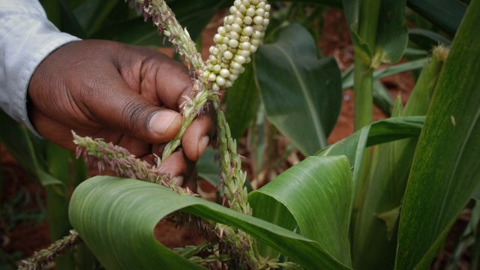

PAGE: 4 - FOOD FOR MANKIND
AGRICULTURE FOR FOOD PRODUCTION
DR.PRAKIT SUKYAI

Slide 6

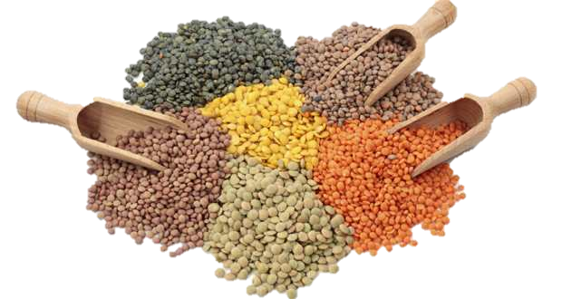

PAGE: 6 - FOOD FOR MANKIND
STAPLE
FOOD
DR.PRAKIT SUKYAI

Slide 7


PAGE: 5 - FOOD FOR MANKIND
FOOD FOR LIFE ?
The past...
Eating for Living
The present...
Eating for Happiness
DR.PRAKIT SUKYAI

Slide 8
PAGE: 7 - FOOD FOR MANKIND
STORAGE
FOOD
PRESERVATION
PROCESSING
QUALITY
PRICE
DR.PRAKIT SUKYAI

Slide 9



PAGE: 8 - FOOD FOR MANKIND
FOOD PRODUCTS
QUALITY
UTILIZATION (concrete)
SATISFACTION (abstract)
DR.PRAKIT SUKYAI

Slide 10


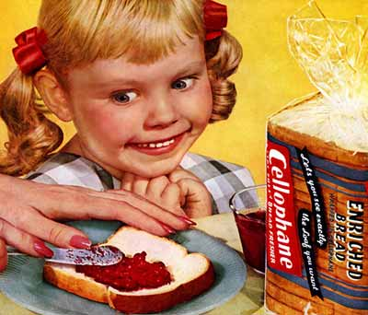

PAGE: 9 - FOOD FOR MANKIND
INFLUENCE OF CONSUMPTION
HABIT
RELIGION
TRADITION
BELIEF
ADVERTISEMENT
CONSUMER
FINANCIAL
CONDITION
DR.PRAKIT SUKYAI

Slide 11





PAGE: 10 - FOOD FOR MANKIND
Quality Factors
Purity & Safety
Usage / Consumption
Convenient
usage / Consumption
Specific characteristics of food
Needs in
Food Quality
Benefits
(Direct / Indirect)
DR.PRAKIT SUKYAI

Slide 12
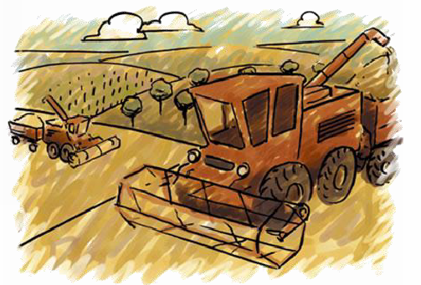
PAGE: 12 - FOOD FOR MANKIND
INDUSTRIAL REVOLUTION
1650-1750
DR.PRAKIT SUKYAI

Slide 13
PAGE: 13 - FOOD FOR MANKIND
INDUSTRIAL EVOLUTION
Industrial Revolution
Industry
Large quantity of food
Economy and Politics
Processing
Colonisation
Price
World War I, II
Changing...
DR.PRAKIT SUKYAI

Slide 14
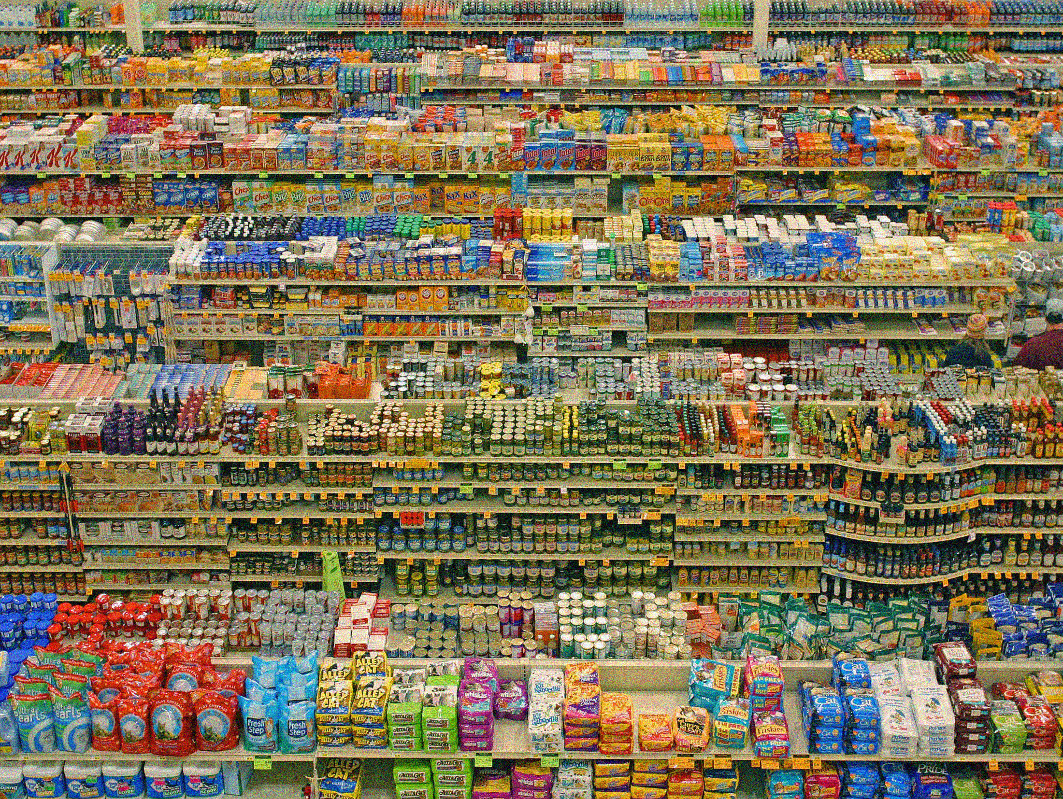
PAGE: 14 - FOOD FOR MANKIND
CHANGING…….
Economic
Society
Culture
Structure of family institution
Etc.
DR.PRAKIT SUKYAI

Slide 15
PAGE: 15 - FOOD FOR MANKIND
Effect of changing...
Food requirement
Logistic
Food price
Increasing
Malnutrition
DR.PRAKIT SUKYAI

Slide 16

PAGE: 16 - FOOD FOR MANKIND
FOOD FOR HUMAN
PAST
PRESENT
DR.PRAKIT SUKYAI

Slide 17
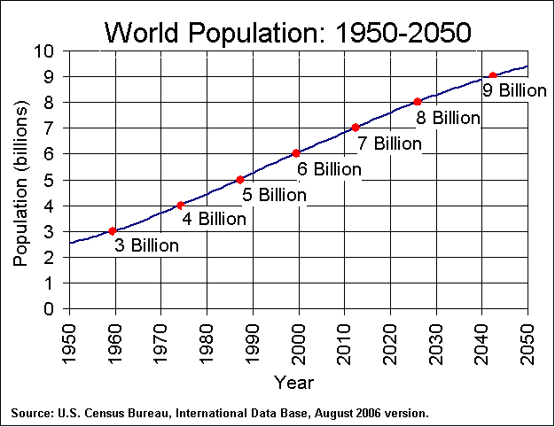
PAGE: 17 - FOOD FOR MANKIND
DR.PRAKIT SUKYAI

Slide 18
World Population in 1990 and 2020
Population (Billion)
Asia
Africa
Latin America
Europe
Russia
North America
PAGE: 18 - FOOD FOR MANKIND
DR.PRAKIT SUKYAI

Slide 19
Poverty of Developing Countries in 1990 and 2020
Area | Population under poverty line* (%)
 | 1990 | 2020
South Asia | 49.0 | 36.9
East Asia | 11.3 | 4.2
Africa (Sahara Desert) | 47.8 | 49.7
Middle East and North Africa | 33.1 | 30.6
Latin America and Caribbean Zone | 25.5 | 24.9
Total of Developing Countries | 29.7 | 24.1
* Poverty line = Income line (per person) = 1.25 US$/day
Source : Worldbank (1992)
Thailand Population below poverty line
: 7.8% (2010)
PAGE: 19 - FOOD FOR MANKIND
DR.PRAKIT SUKYAI

Slide 20
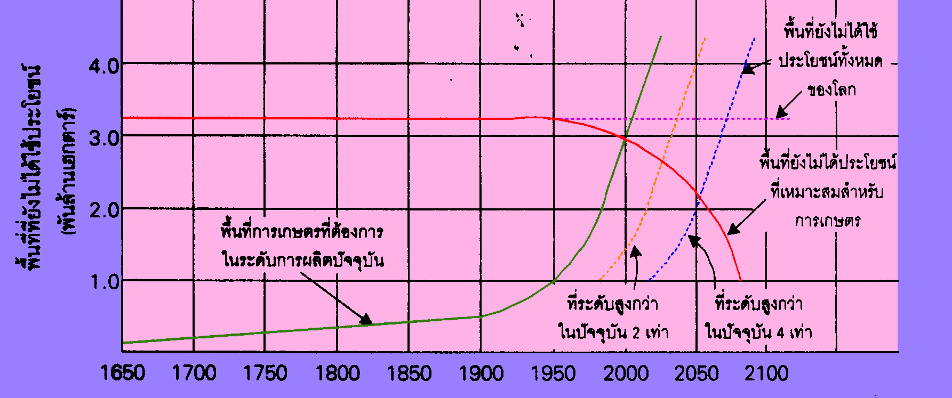
Forecast of Agricultural Area
Un-usefulness area
world
Un-usefulness area
(Billion Hectare
Un-useful
agricultural area
required agricultural area
at the present
High-level area
more than
two times
at the present
High-level area
more than
four times
at the present
PAGE: 20 - FOOD FOR MANKIND
DR.PRAKIT SUKYAI

Slide 21
The International Model for Policy Analysis of
Agricultural Commodities and Trade ( IMPAC)
Objectives : Policy Analysis on Agricultural products
Baseline
Assessment of productivity of agricultural products
1980s -1990s
Low population growth
Decreasing growth rate of the world population
(1% per year)
Low investment /Slow growth
Decreasing growth rate of non-agricultural income
and investment (25%)
High investment /Rapid growth
Increasing growth rate of non-agricultural income
and investment (25%)
Free trade
No tax for imported countries
no support for exported countries
PAGE: 21 - FOOD FOR MANKIND
DR.PRAKIT SUKYAI

Slide 22
Food consumption per person in 1990 and 2020
region/countries | 1990 | 2020
 |  | Baseline | Low population growth | Low Investment / slow growth | High Investment / Rapid growth | Trade liberalization
(Kcal per day)
World Developed countries Developing countries Asia China South Asia Bangladesh India Pakistan Etc. | 2,773 3,353 2,500 2,500 2,667 2,297 1,987 2,332 2,370 2,239 | 2,895 3,532 2,821 3,034 3,408 2,640 2,170 2,692 2,584 2,565 | 2,987 3,613 2,916 3,136 3,457 2,778 2,363 2,814 2,758 2,686 | 2,758 3,492 2,662 2,851 3,271 2,425 1,881 2,490 2,382 2,328 | 3,032 3,599 2,978 3,225 3,616 2,831 2,350 2,886 2,753 2,787 | 2,897 3,512 2,836 3,083 3,420 2,711 2,557 2,736 2,573 2,532
Source : Rosegent et al., 1995
PAGE: 22 - FOOD FOR MANKIND
DR.PRAKIT SUKYAI

Slide 23
The global market of products price in 1990 and 2020
Products | 1990 | 2020
 |  | Baseline | Low population growth | Low Investment / slow growth | High Investment / Rapid growth | Trade liberalization
(US$ per ton)
Meat Pork Sheep poultry egg wheat rice | 2,062 1,664 1,907 739 897 156 231 | 1,947 1,500 1,825 662 668 132 181 | 1,756 1,385 1,694 616 611 105 141 | 1,971 1,487 1,894 660 626 166 256 | 2,035 1,590 1,909 688 696 128 161 | 2,143 1,475 1,991 703 681 136 199
Source : Rosegent et al., 1995
PAGE: 23 - FOOD FOR MANKIND
DR.PRAKIT SUKYAI

Slide 24
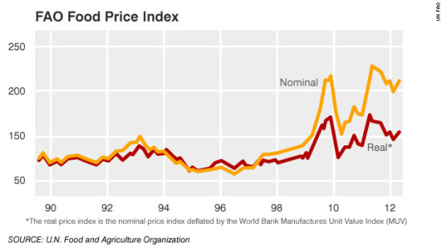
FAO FOOD PRICE INDEX
PAGE: 29 - FOOD FOR MANKIND
DR.PRAKIT SUKYAI

Slide 25
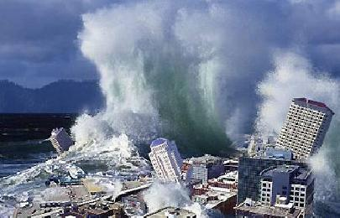
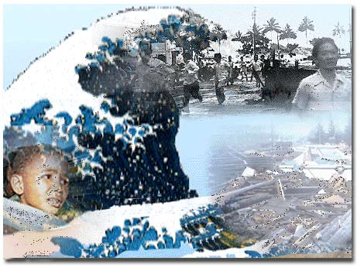
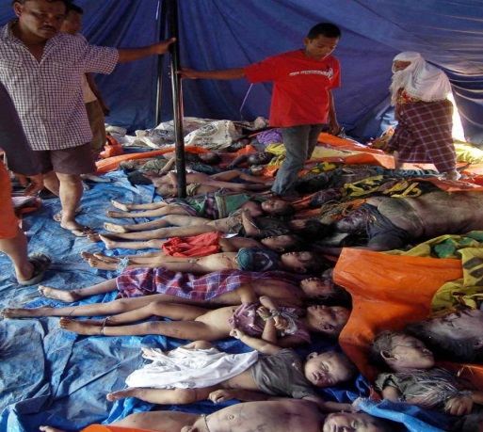
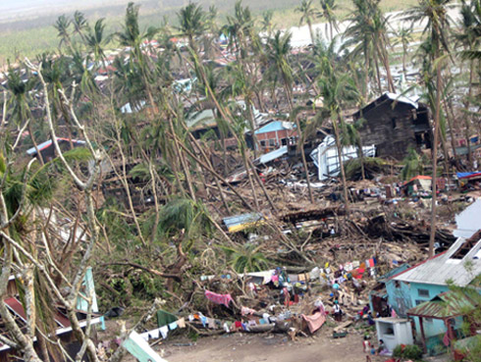
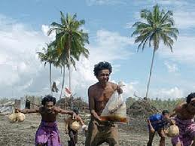
NATURE DISASTER
PAGE: 24 - FOOD FOR MANKIND
DR.PRAKIT SUKYAI

Slide 26
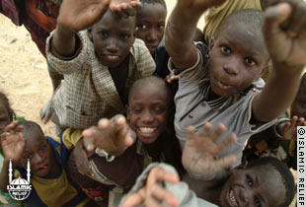
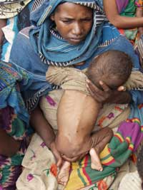
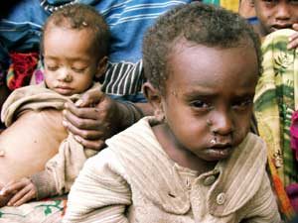
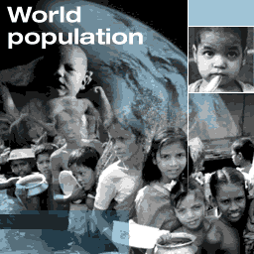
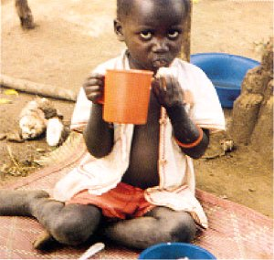
Malnutrition in Developing Countries
PAGE: 25 - FOOD FOR MANKIND
DR.PRAKIT SUKYAI

Slide 27
Challenge in 2020
Increasing of productivity
in poor countries
Productivity
under limited conditions
Challenge
(2020)
Increasing of
income and employment
Reduction of malnutrition
PAGE: 28 - FOOD FOR MANKIND
DR.PRAKIT SUKYAI

Slide 28
THANK YOU FOR YOUR ATTENTION
DR. PRAKIT SUKYAI
DEPARTMENT OF BIOTECHNOLOGY FACULTY OF AGRO-INDUSTRY

